Slide 1

Libraries 2015
Nationwide Visitation Trends
Nora Keenan
April 14, 2019

Slide 2

Dataset: Library and Technology Use - 2015
Library and Technology Use: March 17 - April 12, 2015
Telephone survey of 1601 respondents.
Annual Survey Administered Nationwide by Princeton Survey Research Associates for Pew Research Center
http://www.pewinternet.org/2015/09/15/libraries-at-the-crossroads/

Slide 3
Problem
Libraries do a good job of appealing to community members with higher incomes and education levels.
Would it be possible to learn from the data ways to expand the appeal to other segments of the community?
Use statistics, visualizations and correlation analysis to find other features and insight.

Slide 4
Data Cleansing
Limit dataset features to those that could be related to a the telephone survey script. Many features could not be related because Pew only provided a copy of the 2016 survey, not the 2015 survey. Nine features were retained, along with demographic information for a total of twenty initial features.
Addition of a flag column for whether or not the respondent had ever visited the library: has_visited.
Added a column to create an ordinal value for income and education levels: inc_ordinal, educ2_ordinal.
Added columns for categorical variables using the Pandas get_dummies function.
Renamed columns to be more clearly understood and representative.
Updated data values to reflect the survey response rather than the number representation. E.g., changed 1 to “Male” and 2 to “Female”.

Slide 5
Visualizations

Slide 6
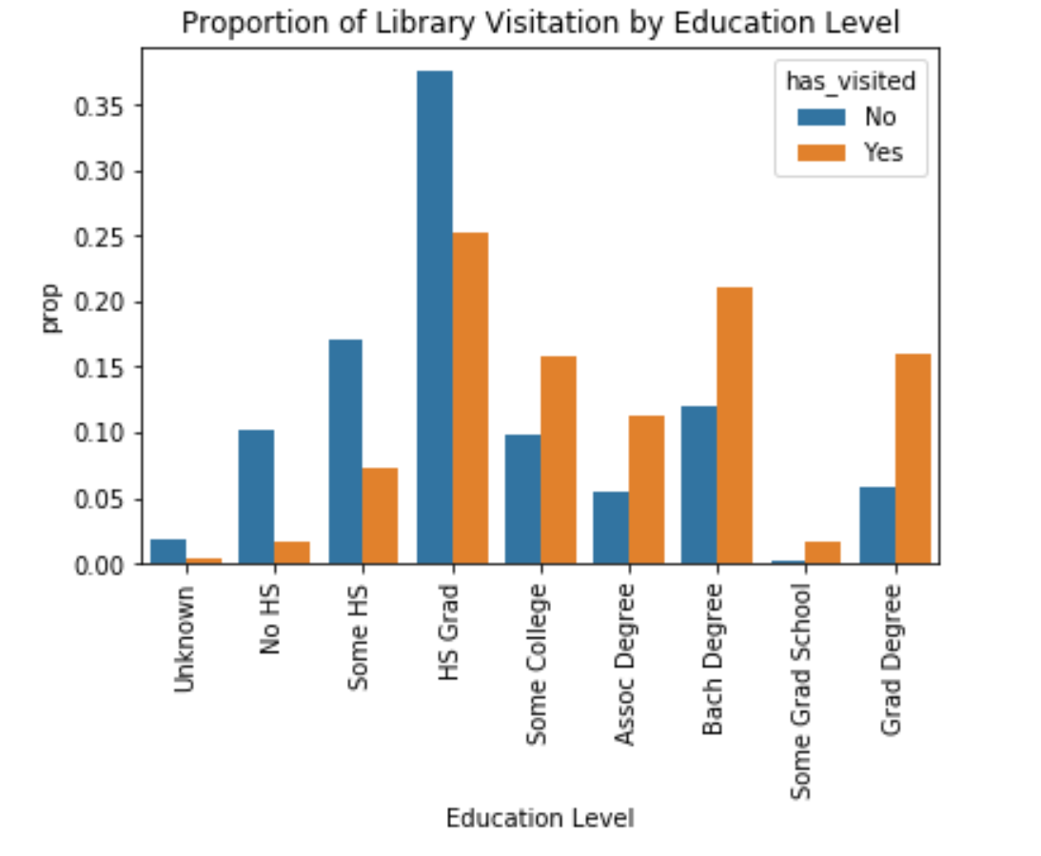
Library Visitation by Education Level

Slide 7
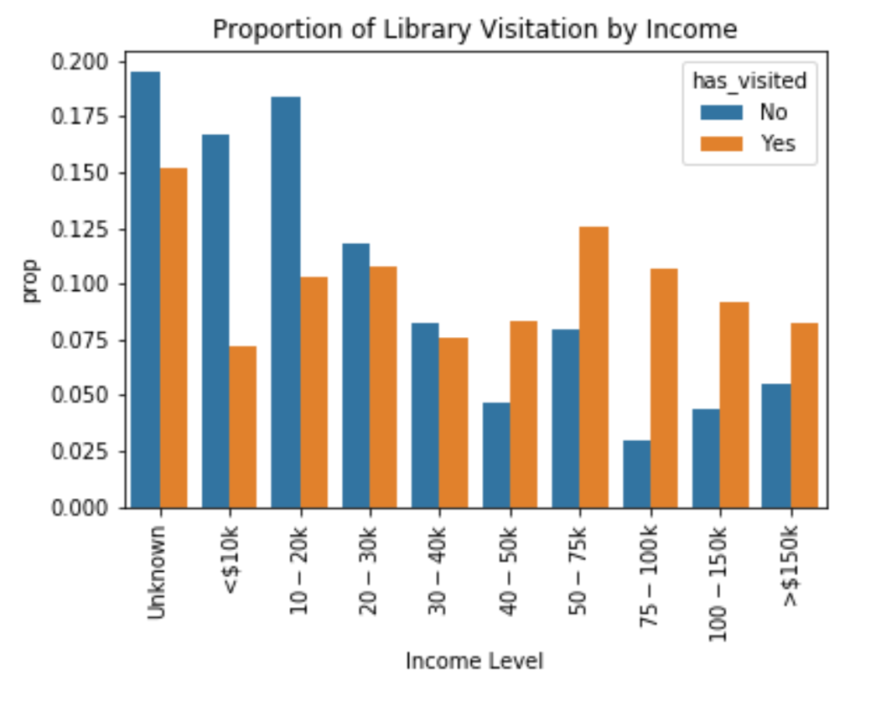
Library Visitation by Income

Slide 8
Inferential Statistics

Slide 9
Correlation Analysis: Visitation by Feature
Strongest Positive Correlations:
High Speed Broadband at Home 0.266
Has Internet at Home 0.265
Education Level 0.255
Uses Email 0.252
Income Level 0.174
Strongest Negative Correlations:
Unknown Broadband at Home -0.258
Doesn’t Use Email -0.251
Unknown Home Internet -0.209
No High School -0.184
Probably a Registered Voter -0.146

Slide 10
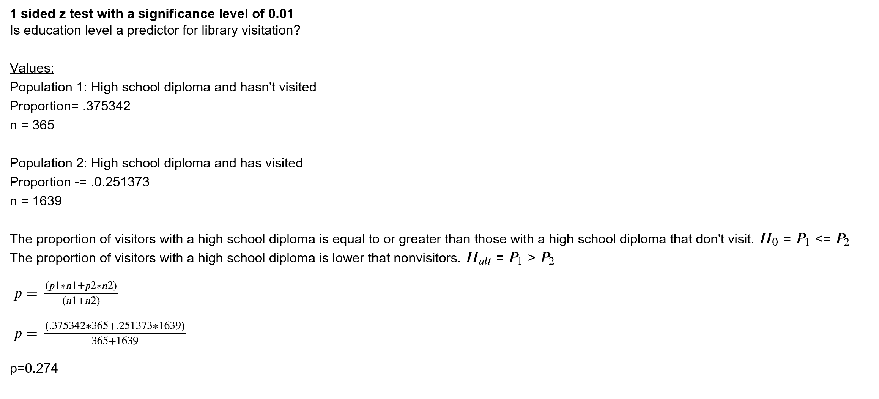
Education Level Significance: 1 Sided z Test

Slide 11
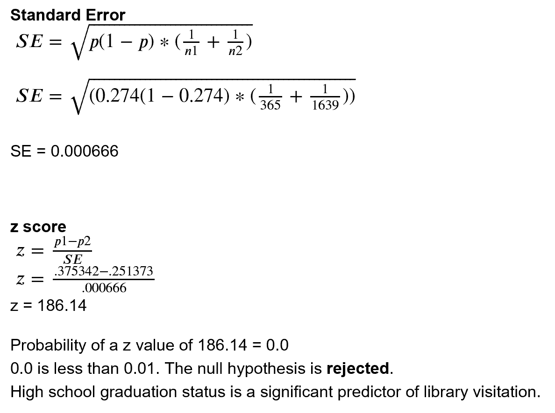

Slide 12
Machine Learning
Chose a Classifier algorithm due to the highly categorical features
Optimized features for machine learning analysis
Tuned models using GridSearch

Slide 13
Machine Learning
Analyzed train and test set accuracy
Created Confusion Matrices for each model
Determine that AdaBoost did the best job of prediction library visitation

Slide 14
Algorithm Results
Algorithm Name | Train Accuracy | Test Accuracy | AUC_ROC Value
Random Forest | 0.907 | 0.821 | 0.565
AdaBoost | 0.837 | 0.822 | 0.577
Gradient Boost | 0.887 | 0.822 | 0.562
KNeighbors | 0.823 | 0.818 | 0.520

Slide 15
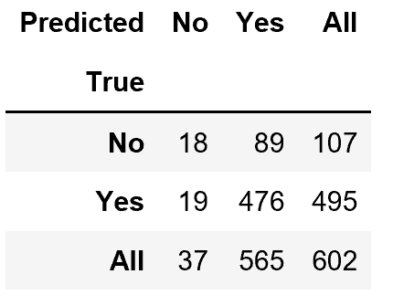
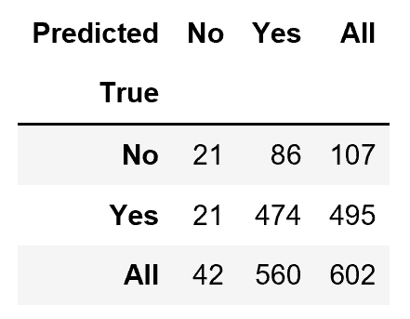
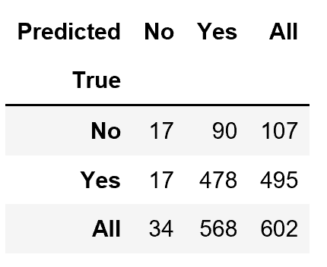
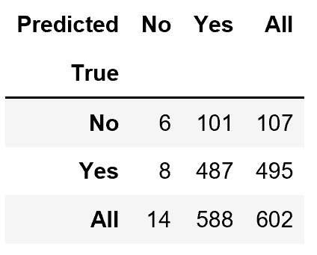
Confusion Matrices
Random Forest | AdaBoost
Gradient Boosted | KNeighbors

Slide 16
Conclusion
Of the algorithms tested, the most successful was the AdaBoost as demonstrated by the following:
Tied with Gradient Boosted Classifier for Test Accuracy
Higher ROC_AUC value (A: 0.577 vs GB: 0.562)
Does a better job of predicting “no” visitors: (A: 21 vs GB: 17)

Slide 17
Conclusion
None of the machine learning models did a great job of predicting whether or not a respondent had visited the library. I believe that the classifier type of algorithm was the correct one, but that the features had too many response options. With each response, the algorithm had fewer and fewer samples to work with.
If I were to continue working with this dataset, I would look for results from additional surveys and combine them to make a larger dataset. I would also them combine some of the demographic responses into groups of similar types.

